Slide 1
NumPy for Machine Learning

Slide 2
Let’s start
First we'll import the NumPy package and set seeds for reproducibility so that we can receive the exact same results every time.
import numpy as np
# Set seed for reproducibility
np.random.seed(seed=1234)
The seed value in NumPy is a fundamental concept for controlling the behavior of its Pseudo-Random Number Generators (PRNGs).
PRNGs are deterministic algorithms. They don't generate truly random numbers; they generate a long sequence of numbers based on an initial input value (the seed)
In scientific computing, machine learning, and especially when writing technical blogs, you must ensure that your code yields identical results every time someone runs it. Setting the seed guarantees this consistency.

Slide 3
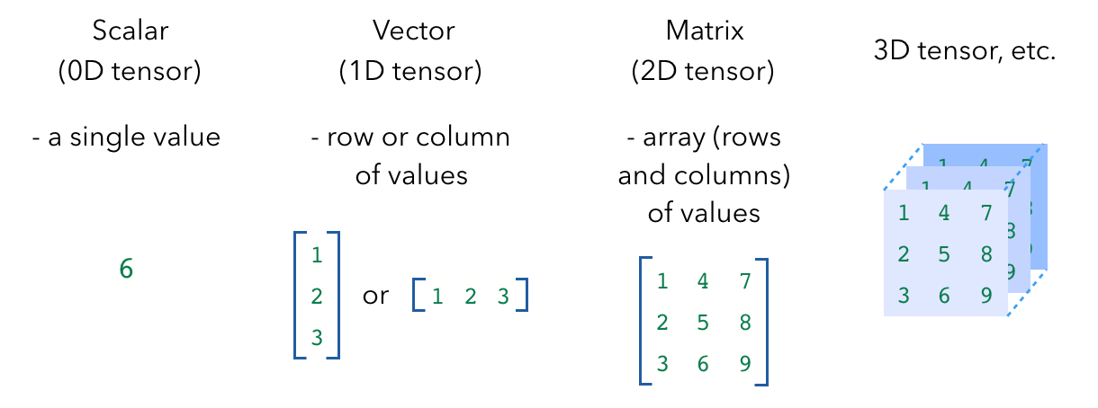
Scalar/Vector/Matrix/3D tensor

Slide 4
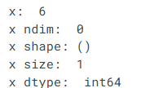
Basic properties of Numpy array # Scalar
# Scalar
x = np.array(6)
print ("x: ", x)
print ("x ndim: ", x.ndim) # number of dimensions
print ("x shape:", x.shape) # dimensions
print ("x size: ", x.size) # size of elements
print ("x dtype: ", x.dtype) # data type

Slide 5
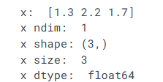
Basic properties of Numpy array # Vector
# Vector
x = np.array([1.3 , 2.2 , 1.7])
print ("x: ", x)
print ("x ndim: ", x.ndim)
print ("x shape:", x.shape)
print ("x size: ", x.size)
print ("x dtype: ", x.dtype) # notice the float datatype

Slide 6
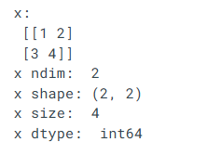
Basic properties of Numpy array # Matrix
# Matrix
x = np.array([[1,2], [3,4]])
print ("x:\n", x)
print ("x ndim: ", x.ndim)
print ("x shape:", x.shape)
print ("x size: ", x.size)
print ("x dtype: ", x.dtype)

Slide 7
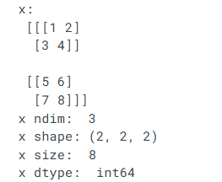
Basic properties of Numpy array # 3-D Tensor
# 3-D Tensor
x = np.array([[[1,2],[3,4]],[[5,6],[7,8]]])
print ("x:\n", x)
print ("x ndim: ", x.ndim)
print ("x shape:", x.shape)
print ("x size: ", x.size)
print ("x dtype: ", x.dtype)

Slide 8
NumPy also comes with several functions that allow us to create tensors quickly
# Functions
print ("np.zeros((2,2)):\n", np.zeros((2,2)))
print ("np.ones((2,2)):\n", np.ones((2,2)))
print ("np.eye((2)):\n", np.eye((2))) # identity matrix
print ("np.random.random((2,2)):\n", np.random.random((2,2)))

Slide 9
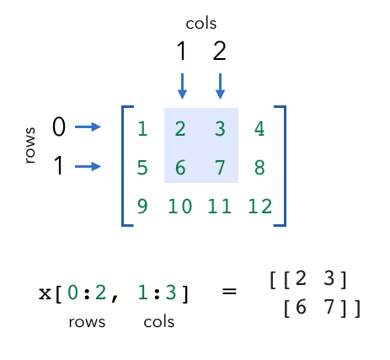
Indexing
We can extract specific values from our tensors using indexing.
Keep in mind that when indexing the row and column, indices start at 0. And like indexing with lists, we can use negative indices as well (where -1 is the last item).

Slide 10

Indexing
# Indexing
x = np.array([1, 2, 3])
print ("x: ", x)
print ("x[0]: ", x[0])
x[0] = 0
print ("x: ", x)

Slide 11
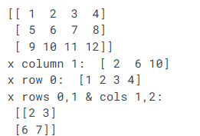
# Slicing
x = np.array([[1,2,3,4], [5,6,7,8], [9,10,11,12]])
print (x)
print ("x column 1: ", x[:, 1])
print ("x row 0: ", x[0, :])
print ("x rows 0,1 & cols 1,2: \n", x[0:2, 1:3]

Slide 12
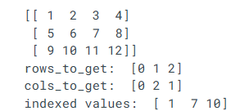
# Integer array indexing
# Integer array indexing
print (x)
rows_to_get = np.array([0, 1, 2])
print ("rows_to_get: ", rows_to_get)
cols_to_get = np.array([0, 2, 1])
print ("cols_to_get: ", cols_to_get)
# Combine sequences above to get values to get
print ("indexed values: ", x[rows_to_get, cols_to_get]) # (0, 0), (1, 2), (2, 1)

Slide 13
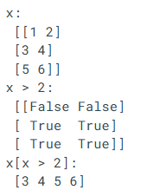
Boolean array indexing
# Boolean array indexing
x = np.array([[1, 2], [3, 4], [5, 6]])
print ("x:\n", x)
print ("x > 2:\n", x > 2)
print ("x[x > 2]:\n", x[x > 2])

Slide 14
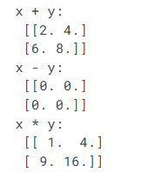
Arithmetic
# Basic math
x = np.array([[1,2], [3,4]], dtype=np.float64)
y = np.array([[1,2], [3,4]], dtype=np.float64)
print ("x + y:\n", np.add(x, y)) # or x + y
print ("x - y:\n", np.subtract(x, y)) # or x - y
print ("x * y:\n", np.multiply(x, y)) # or x * y

Slide 15
Dot product
One of the most common NumPy operations we’ll use in machine learning is matrix multiplication using the dot product. Suppose we wanted to take the dot product of two matrices with shapes [2 X 3] and [3 X 2]. We take the rows of our first matrix (2) and the columns of our second matrix (2) to determine the dot product, giving us an output of [2 X 2].
The only requirement is that the inside dimensions match, in this case the first matrix has 3 columns and the second matrix has 3 rows.

Slide 16
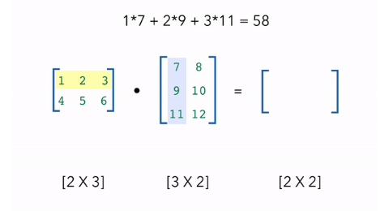
Dot Product Step (1st matrix 1st row * 2nd matrix 1st column)

Slide 17
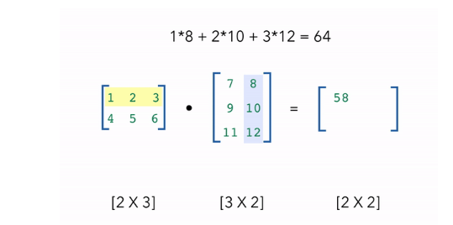
2nd steps (1st matrix 1st row * 2nd matrix 2nd column)

Slide 18
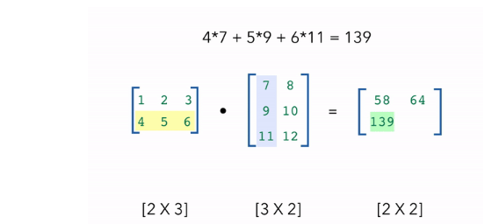
3rd steps (1st matrix 2nd row * 2nd matrix 1st column)

Slide 19
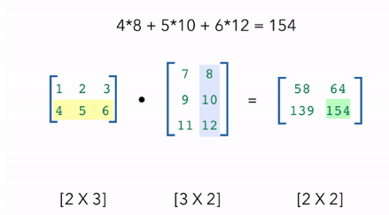
3rd steps (1st matrix 2nd row * 2nd matrix 2nd column)

Slide 20

# Dot product
# Dot product
a = np.array([[1,2,3], [4,5,6]], dtype=np.float64) # we can specify dtype
b = np.array([[7,8], [9,10], [11, 12]], dtype=np.float64)
c = a.dot(b)
print (f"{a.shape} · {b.shape} = {c.shape}")
print (c)

Slide 21
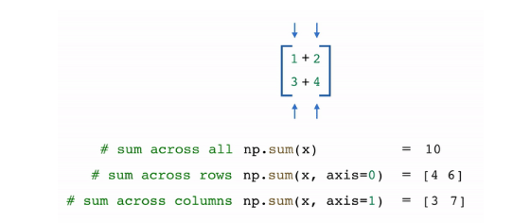
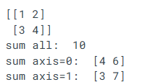
Axis operations
We can also do operations across a specific axis.
# Sum across a dimension
x = np.array([[1,2],[3,4]])
print (x)
print ("sum all: ", np.sum(x)) # adds all elements
print ("sum axis=0: ", np.sum(x, axis=0)) # sum across rows
print ("sum axis=1: ", np.sum(x, axis=1)) # sum across columns

Slide 22

# Min/max
x = np.array([[1,2,3], [4,5,6]])
print ("min: ", x.min())
print ("max: ", x.max())
print ("min axis=0: ", x.min(axis=0))
print ("min axis=1: ", x.min(axis=1))

Slide 23
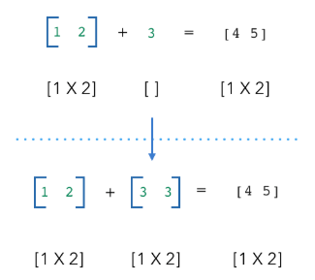
Broadcast
What happens when we try to do operations with tensors with seemingly incompatible shapes? Their dimensions aren’t compatible as is but how does NumPy still gives us the right result? This is where broadcasting comes in. The scalar is broadcast across the vector so that they have compatible shapes.

Slide 24
# Broadcasting
# Broadcasting
x = np.array([1,2]) # vector
y = np.array(3) # scalar
z = x + y
print ("z:\n", z)

Slide 25

Gotchas
a = np.array((3, 4, 5))
b = np.expand_dims(a, axis=1)
c = a + b
a.shape # (3,)
b.shape # (3, 1)
c.shape # (3, 3)
print (c)

Slide 26
How can we fix this? We need to be careful to ensure that a is the same shape as b if we don't want this unintentional broadcasting behavior.

Slide 27

if we don't want this unintentional broadcasting behavior
a = a.reshape(-1, 1)
a.shape # (3, 1)
c = a + b
c.shape # (3, 1)
print (c)

Slide 28
Reshape
This kind of unintended broadcasting happens more often then you'd think because this is exactly what happens when we create an array from a list. So we need to ensure that we apply the proper reshaping before using it for any operations.
a = np.array([3, 4, 5])
a.shape # (3,)
a = a.reshape(-1, 1)
a.shape # (3, 1)
Notes:
https://madewithml.com/courses/foundations/numpy/

Slide 29
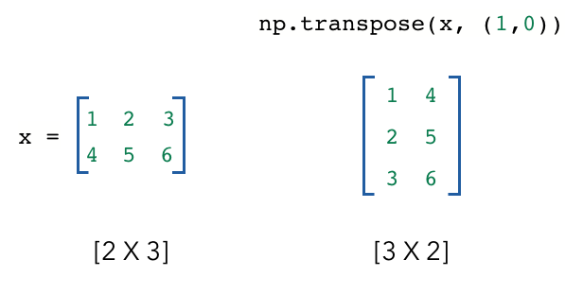
Transpose
We often need to change the dimensions of our tensors for operations like the dot product. If we need to switch two dimensions, we can transpose the tensor.

Slide 30
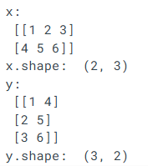
Transposing
# Transposing
x = np.array([[1,2,3], [4,5,6]])
print ("x:\n", x)
print ("x.shape: ", x.shape)
y = np.transpose(x, (1,0)) # flip dimensions at index 0 and 1
print ("y:\n", y)
print ("y.shape: ", y.shape)

